Slide 1
Photography
This document is released under Creative Commons License Attribution 4.0 International. Please feel free to share and adapt this document with appropriate credit to Giant Steps School.

Slide 2
Shadow Design

Slide 3
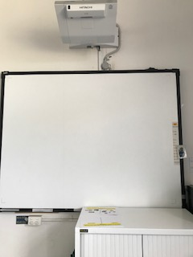
1
2
3
4
Interwrite Board
Make design
worksheet
You tube

Slide 4
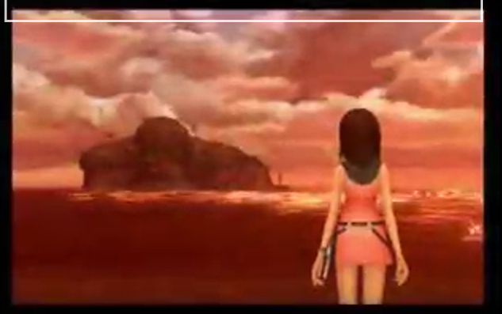
Song

Slide 5
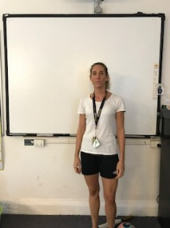
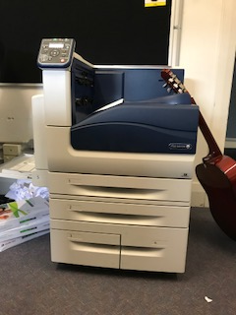
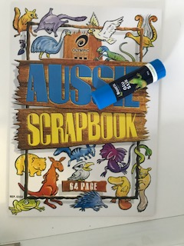
Take photo
1
2
3
4
Trace around Friend
Fill shape
Get photo from printer
Glue in book

Slide 6
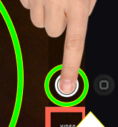
1
2
3
4
unlock
camera
focus
press

Slide 7
slide to unlock iPad

Slide 8
TAP
open camera app

Slide 9
choose photo setting

Slide 10
TAP
find object take picture

Slide 11
zoom in
TAP
pinch
out

Slide 12
zoom out
TAP
pinch
in

Slide 13
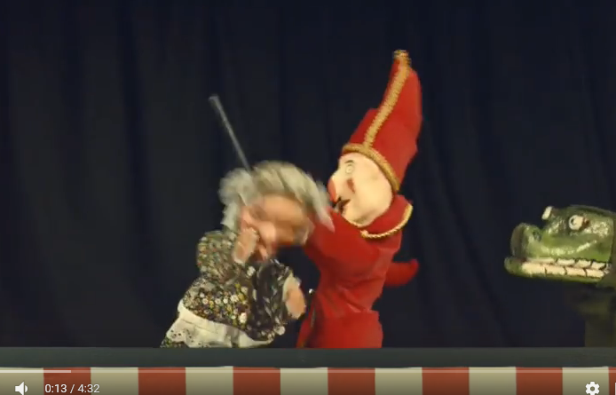
Song

Slide 14
finish

Slide 15
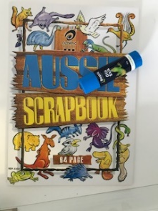
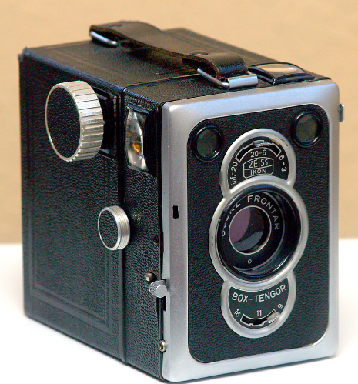
Today we made a
Review
We used the
We glued the picture into our

Slide 19
Edgar
1
2
3
4
U _ _ _ _ _
F_ _ _S
TAKE P_ _ _ _ _
W_ _ _ _ _ _ _ _

Slide 20
Jonah & Luke
1
2
3
4
Unlock iPad
focus
Take photo
worksheet

Slide 21
Aidan
1
2

Slide 22
Take photo
1
2
3
4
Arrange objects on desk
Take photo
Get photo from printer
Glue in book

Slide 23
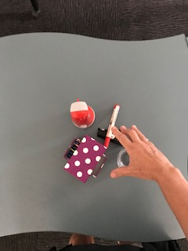
Take photo
1
2
3
4
Arrange objects on desk
Take photo
Get photo from printer
Glue in book

